Slide 1
Customer Churn & Lifetime Value (CLTV) Prediction
Customer Behavior Analysis using RFM, BG/NBD, Gamma-Gamma & K-Means
Presented by:
Komal Bhat
Siddhi Mankar
Aadit Lele
Karthik Swaroop
  Customer Churn: When a customer stops purchasing from a company.
  CLTV: The estimated value a customer can generate during their relationship with a company.

Slide 2

Problem Statement
E-commerce companies need to understand customer behavior to identify customers who may stop purchasing and customers who generate high future value.
Objectives
  Analyze customer transaction behavior
  Create RFM and Tenure features
  Predict customer churn
  Estimate Customer Lifetime Value
  Segment customers based on behavior

Slide 3




Data preprocessing
Dataset
UCI Online Retail II Dataset
Raw Data
↓
Remove Missing Customer IDs
↓
Remove Cancelled Orders
↓
Remove Invalid Quantities & Prices
↓
Remove Non-Product Codes
↓
IQR Outlier Treatment
It contains e-commerce transaction information such as:
  Invoice
  StockCode
  Quantity
  Price
  InvoiceDate
  Customer ID
  Country

Slide 4
RFM & Tenure Feature Engineering
R — Recency
Days since last purchase
Lower value → more recently active
F — Frequency
Number of unique completed orders
Higher value → more frequent purchases
M — Monetary
Total customer spending
Higher value → higher contribution
T — Tenure
Days since first purchase
Shows customer relationship duration
4,285 customer profiles generated

Slide 5
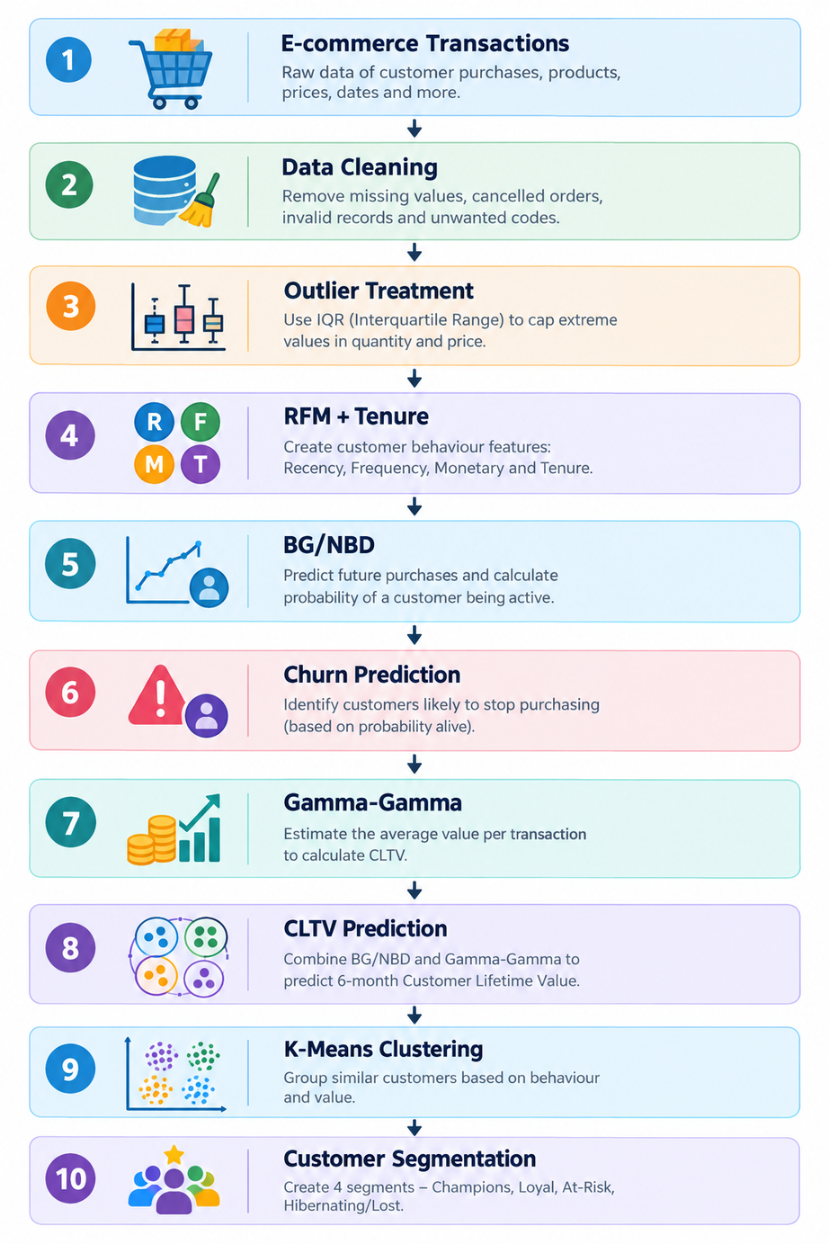
Methodology

Slide 6
Churn Prediction using BG/NBD
BG/NBD ( Beta Geometric / Negative Binomial Distribution) is a model used to estimate how many times a customer may purchase in the future.
What does it do?
It predicts:
  Future purchases
  Probability that a customer is still active
  Churn risk
  Churn Risk → The likelihood that the customer has stopped purchasing.
  Churn Risk = 1 − Probability Alive
  We considered a customer churned when Probability Alive < 0.20.

Slide 7

CLTV PREDICTION & CUSTOMER SEGEMENTATION
Estimating customer value and grouping customers by behavior
CLTV Prediction
Customer Segmentation
BG/NBD (Predicts future purchases)
K- Means
(Groups similar customers)
↓
Gamma-Gamma Model
(Estimates future spending)
↓
4 Customer Segments
  Champions
  Loyal Customers
  At-Risk
  Hibernating/Lost
↓
CLTV ( Predicted customer value)
CLTV = How much value a customer is expected to generate in the future.

Slide 8
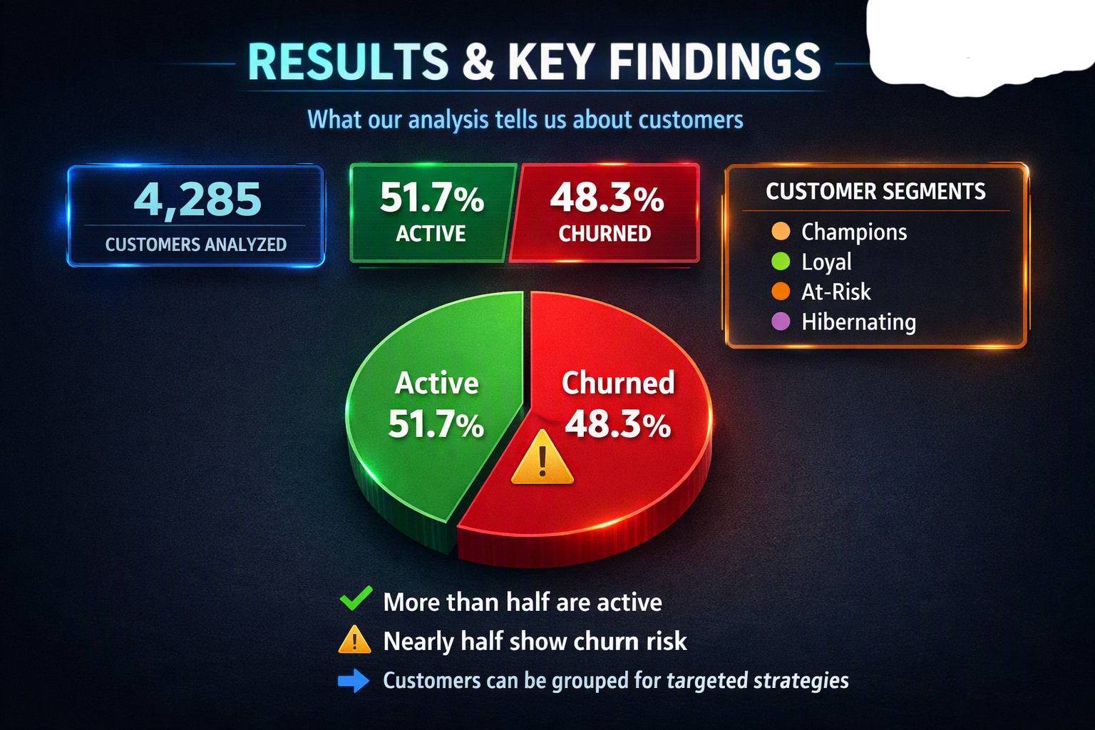

Slide 9
Technology & Project Outputs
Tools used and outputs generated
Technology Stack
Project Outputs
🐍 Python
Main programming language
🗃 Pandas
Data cleaning & analysis
🔢 NumPy
Numerical calculations
📊 Matplotlib / Seaborn
Data visualization
🤖 Scikit-Learn
K-Means clustering
📦 Lifetimes
BG/NBD & Gamma-Gamma models
📄 OpenPyXL
Excel dataset handling
📊 RFM Customer Profiles
4,285 customer profiles
↓
⚠️ Churn Prediction
Active / Churned classification
↓
💰 CLTV Prediction
6-month projected customer value
↓
👥 Customer Segmentation
4 behavioral segments
↓
📁 Final Dataset
Customer-level predictions & segments

Slide 10
Thank
You

